Slide 1
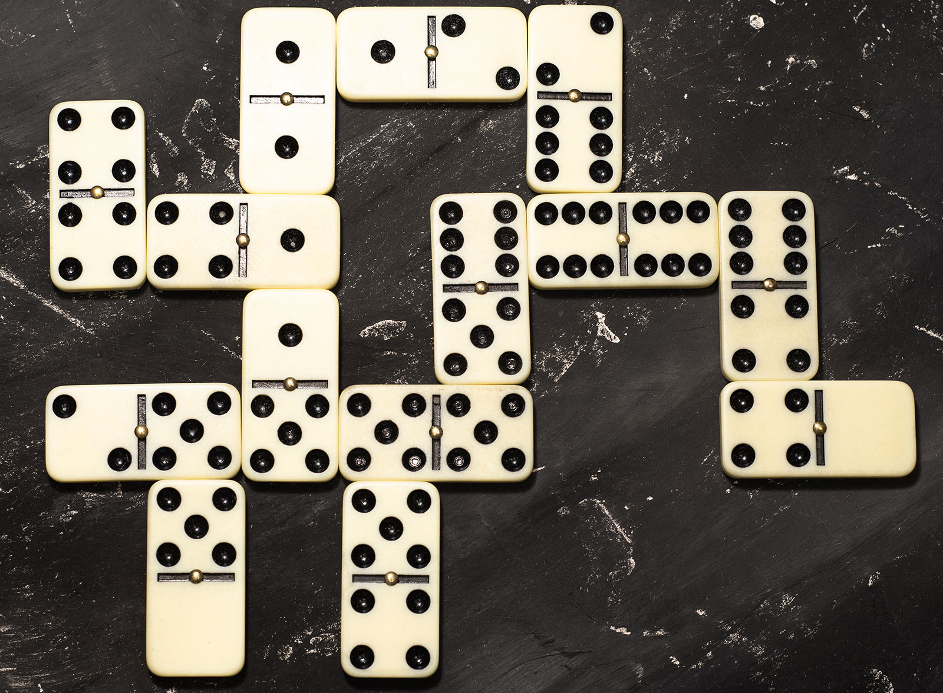

Template matching to find dots on dominoes:
Input image
Template
The template does not have to be from the same image but it should be decent quality for the best results.

Slide 2
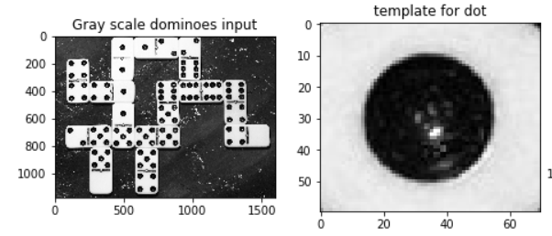
Make them grayscale:

Slide 3
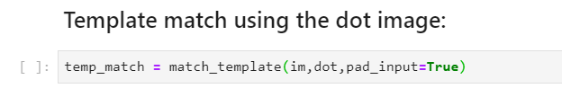
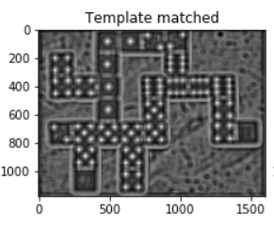
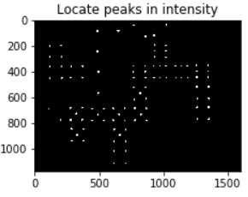
Threshold
Bright spots are where it has detected matches to the template.
These are all the pixels with high insensity,
ie. dots!

Slide 4
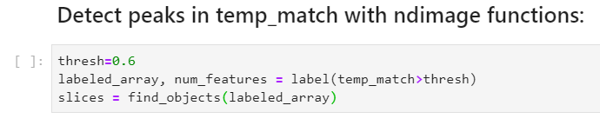
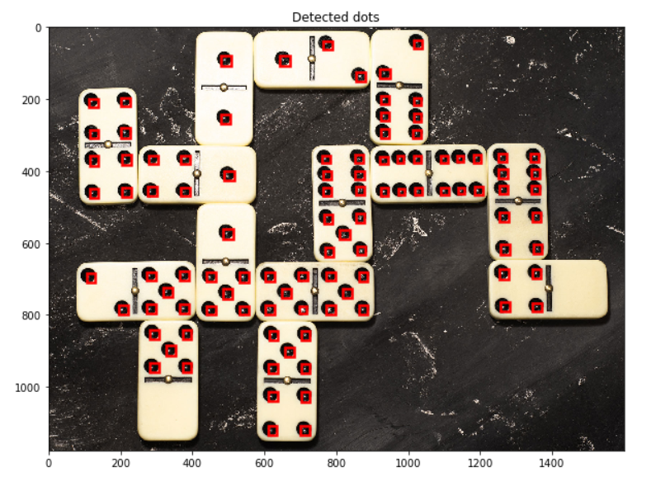
label and find_objects are functions from scipy.ndarray
label creates an array of marks where objects are and counts their number
find_objects returns the location of the objects
Plot boxes at locations

